Slide 1

Using a Genetic Algorithm to Teach
an Agent How to Walk
I’m Walky!
Join me while
I learn how to walk-ish
May Soshi, Ricky Williams,
Omar Abdel Haq, & Elie Eshoa

Slide 2
What is a Genetic Algorithm? Why Use One?
Genetic algorithms (GA) are a class of optimization algorithms inspired by the natural selection and genetic processes observed in biological evolution
Using evolution as a computational tool can elucidate unconventional, high-performing solutions in some cases

Slide 3
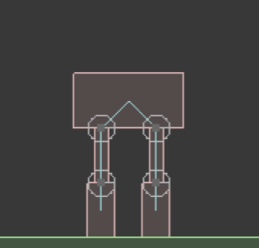
What is a Walker?
Box2D is a 2D rigid body simulation library
A Walker consists of
(1) Head body
(2) Upper Leg bodies
(2) Lower Leg bodies
(4) Joints
0
1
2
3

Slide 4
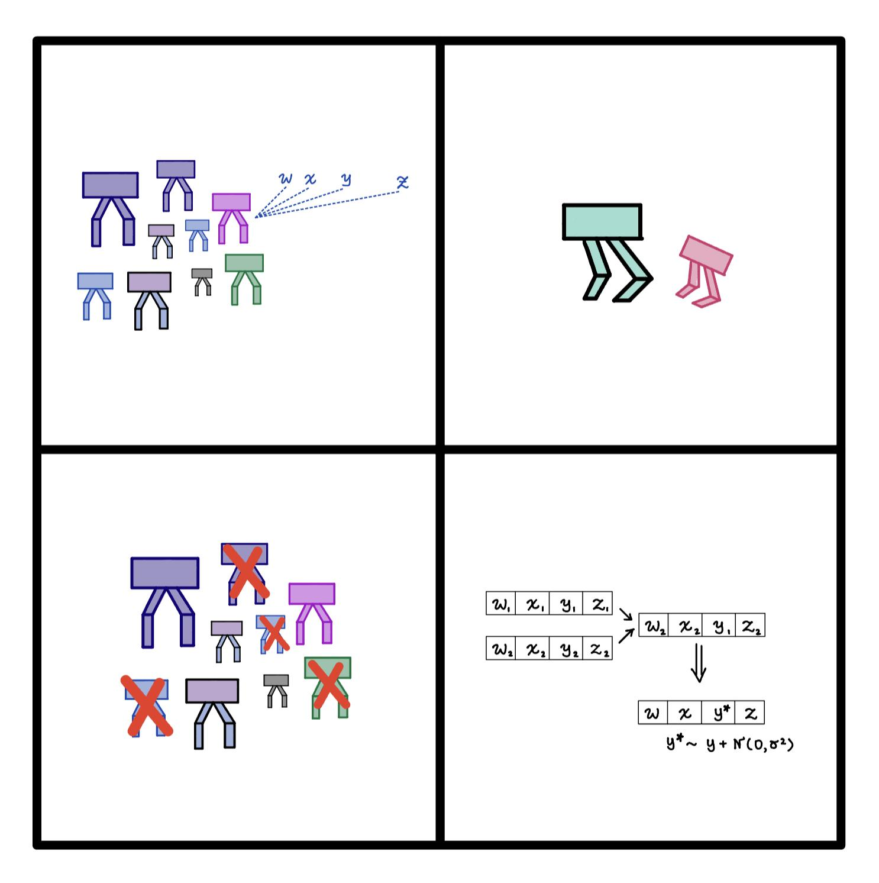
Steps of Our Genetic Algorithm
1. Initialize Population
2. Run Simulations
Initialize a population of walkers with different, randomly selected torques
Run
Select the fittest
Crossover and mutate
Repeat steps 2-4
3. Select Fittest
4. Crossover & Mutate
Notes:
Torques are drawn from a normal distribution
Run the simulation
We select the fittest using our fitness function → displacement of the head at the end of the trial (top ten percent)
Once we have our fittest, we randomly select two of the fittest walkers and crossover their genes [so for each of the four torques, there’s a 50% chance of it being selection) n times
For every gene, there is a ten percent chance of mutation

Slide 5
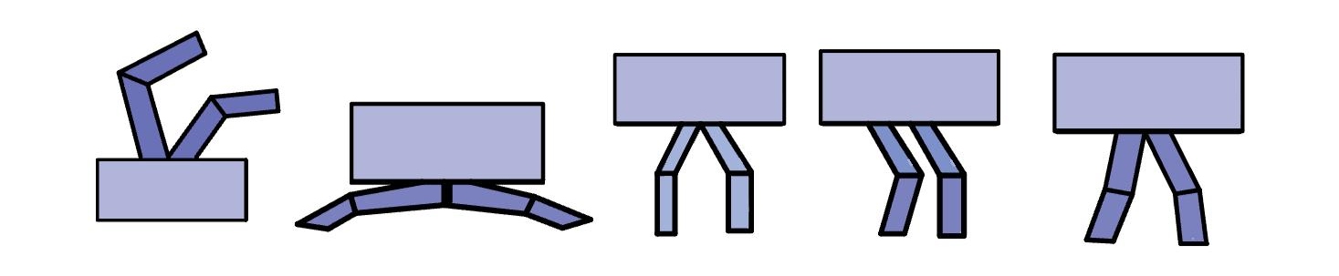
A Full Simulation: A Collection of States
A full simulation comprises of running the genetic algorithm g times for g generations. After a full simulation, we visualize the progress of the best walker using Box2D.
Notes:
Visualize all the steps

Slide 6
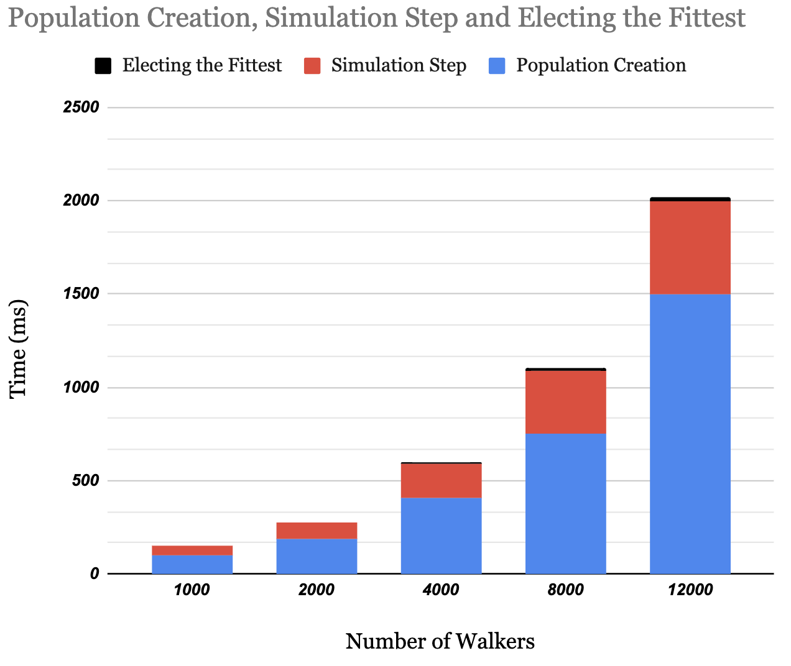
How Can We Improve?
Parallelize Current Serial Implementation: OpenMP
Increase Problem Size: MPI
Notes:
We noticed that the population creation stage and the simulation step were taking the most time → use openmp to parallelize those functions
We explore whether increasing the size of the problem can result in better performance than having more generations

Slide 7
Parallelization I: OpenMP and Scaling Analysis
Using OpenMP, parallelization was done as discussed in MS4
As for our scaling analysis, we have used a standard job during our project development with a population size of 2000. First, we used that to calculate our serial fraction f. To compute it, we follow the following steps:
Assumptions: the code has 3 main (potentially) parallelizable components that depend on the size n:
Creation, Simulation, and Electing the fittest walkers
Taking the ratio of the walltime of running the remaining parts over the total walltime can experimentally help us approximate f , which ended up being around ~0.04

Slide 8
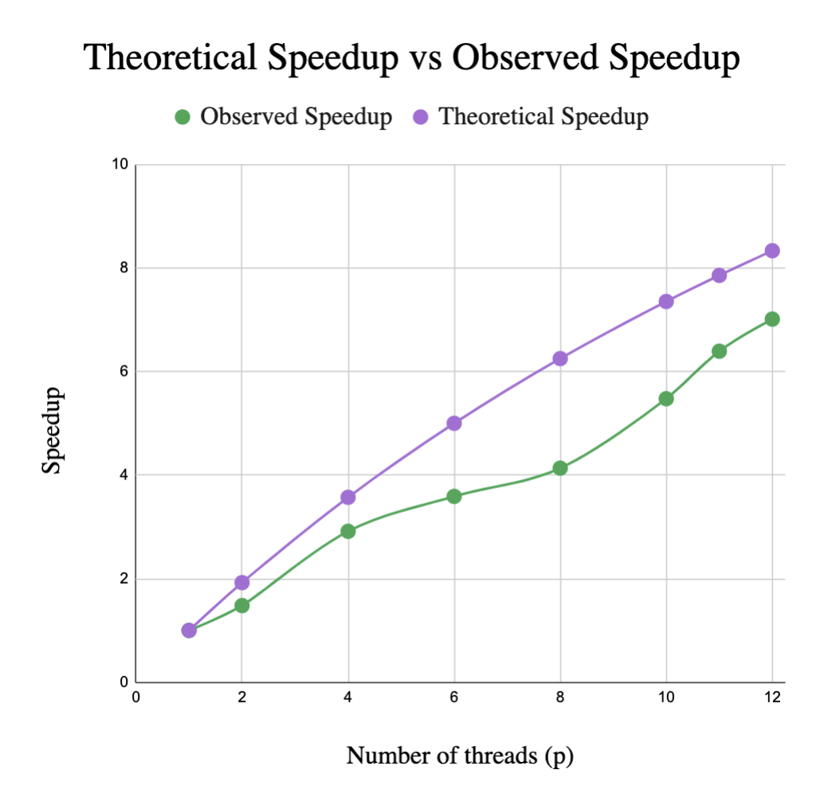
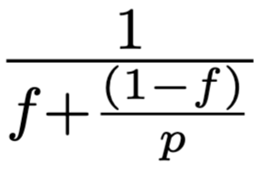
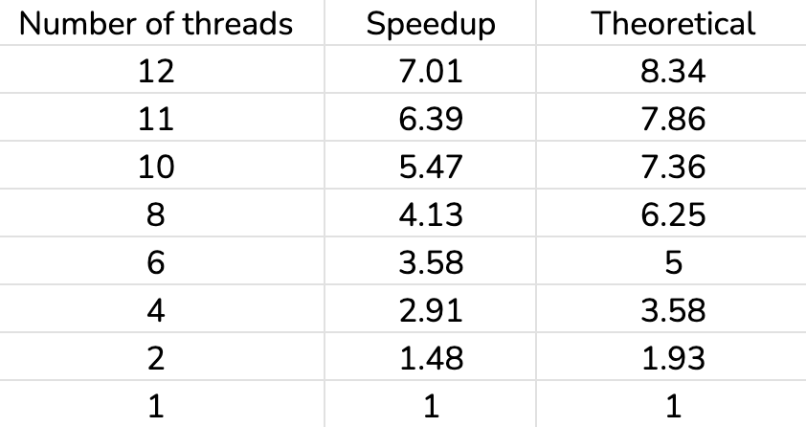
Parallelization I: OpenMP and Strong Scaling
We measured the speedup of the algorithm as a function of the number of threads, while keeping the problem size fixed at 2000. We ran it for 500 iterations.
We compare our speedup to the theoretical speedup (f = 0.04)

Slide 9
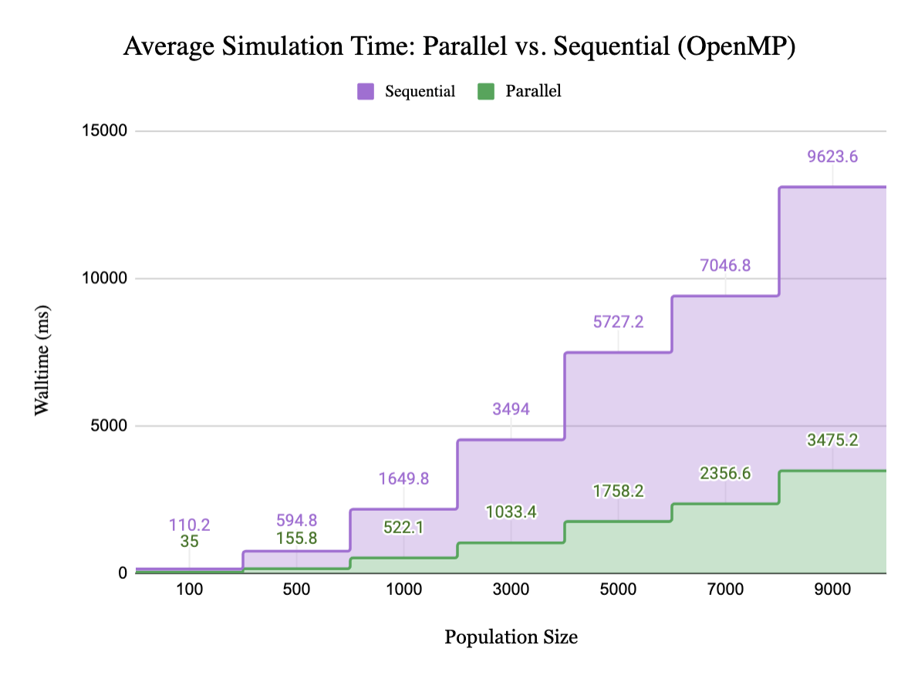
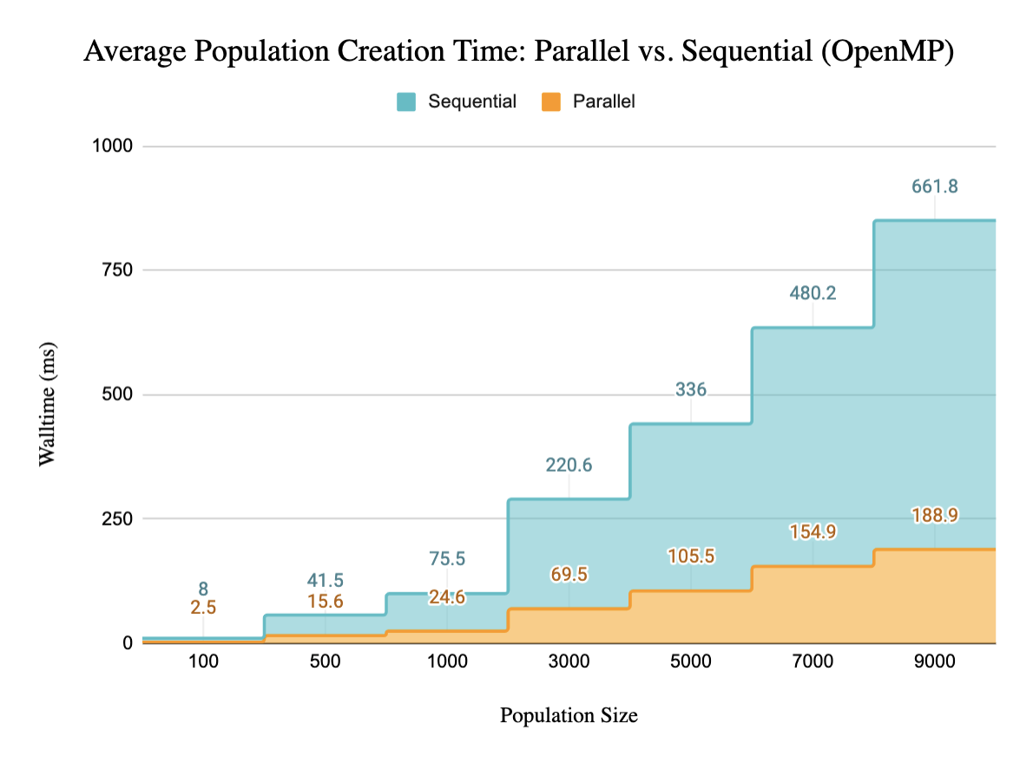
Weak Scaling Growth is linear n ~ p
As we see in the graphs above, the time needed on average (i.e. a timestep in our algorithm) increases linearly with the size of the problem (number of walkers, n)

Slide 10
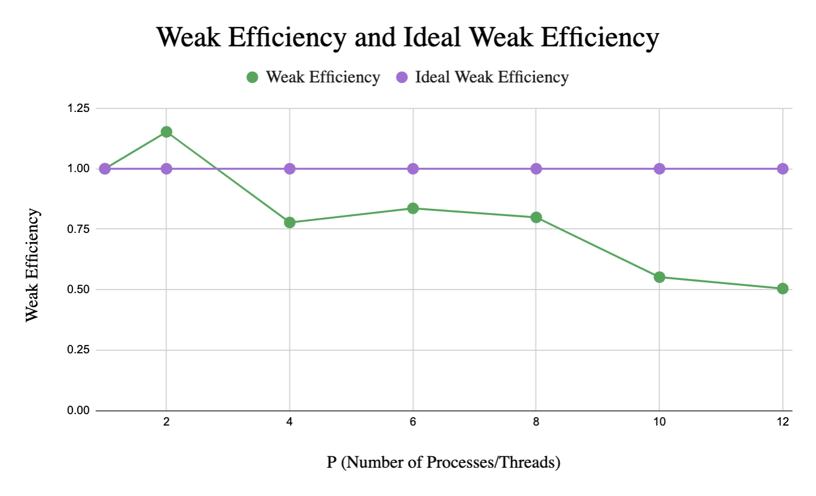
Parallelization I: OpenMP and Weak Scaling
So, we ran 150 iterations (generations) per simulation. We ran simulations with upto p = 12 threads and measured the weak efficiency Ep. Since the relationship is linear, we used the following growth pattern:
n = 200, 400, . . . , 2400 using p = 1, 2, . . . , 12 threads respectively.
The weak efficiency does not stay great because of the probable overhead introduced when scaling over multiple threads. This could be explained because the third-party libraries may be interfering with that, in addition to higher load imbalance throughout the runs.

Slide 11
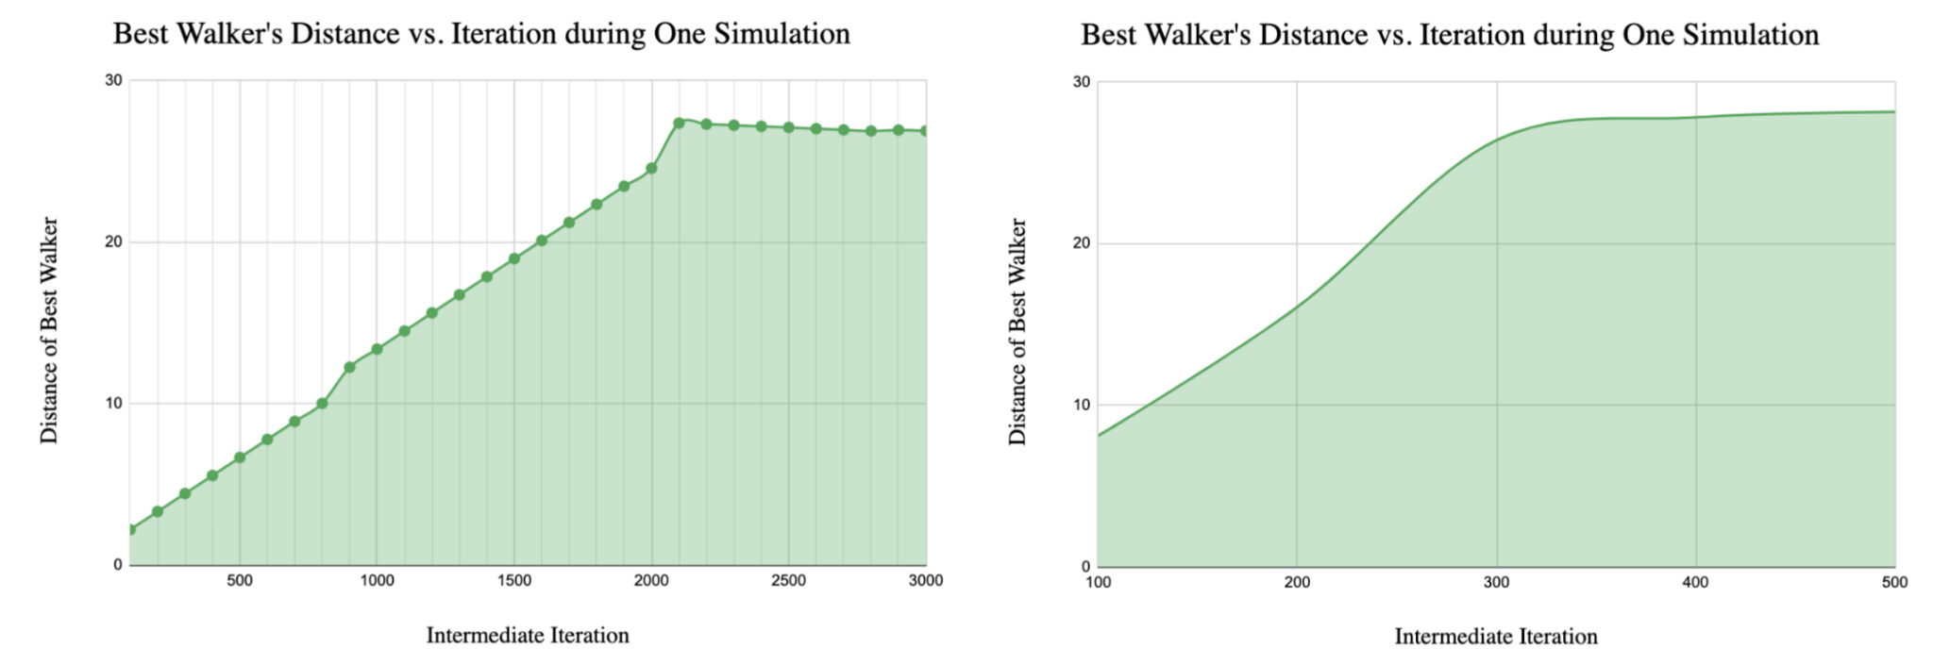
More Populations >> More Generations
Interestingly, we observed a consistent plateauing behavior in the course of our experiments.
This trend can be attributed to the fact that we generate populations at random and persist with them until they can no longer generate improved generations of walkers, limited by genetic mutations. Our investigations have indicated that this plateauing phenomenon is present across all population sizes that we examined. Thus, initializing more random populations is more integral than running a specific population for an increased number of iterations (generations)

Slide 12
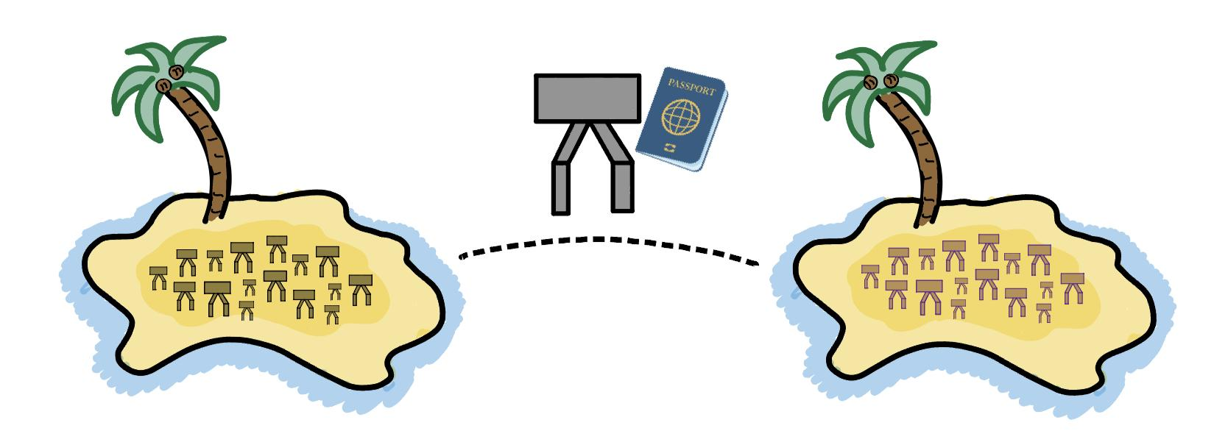
Parallelization II: MPI
What if instead of having one population evolve over generations, we have tens of different populations, each on their own “island”?

Slide 13
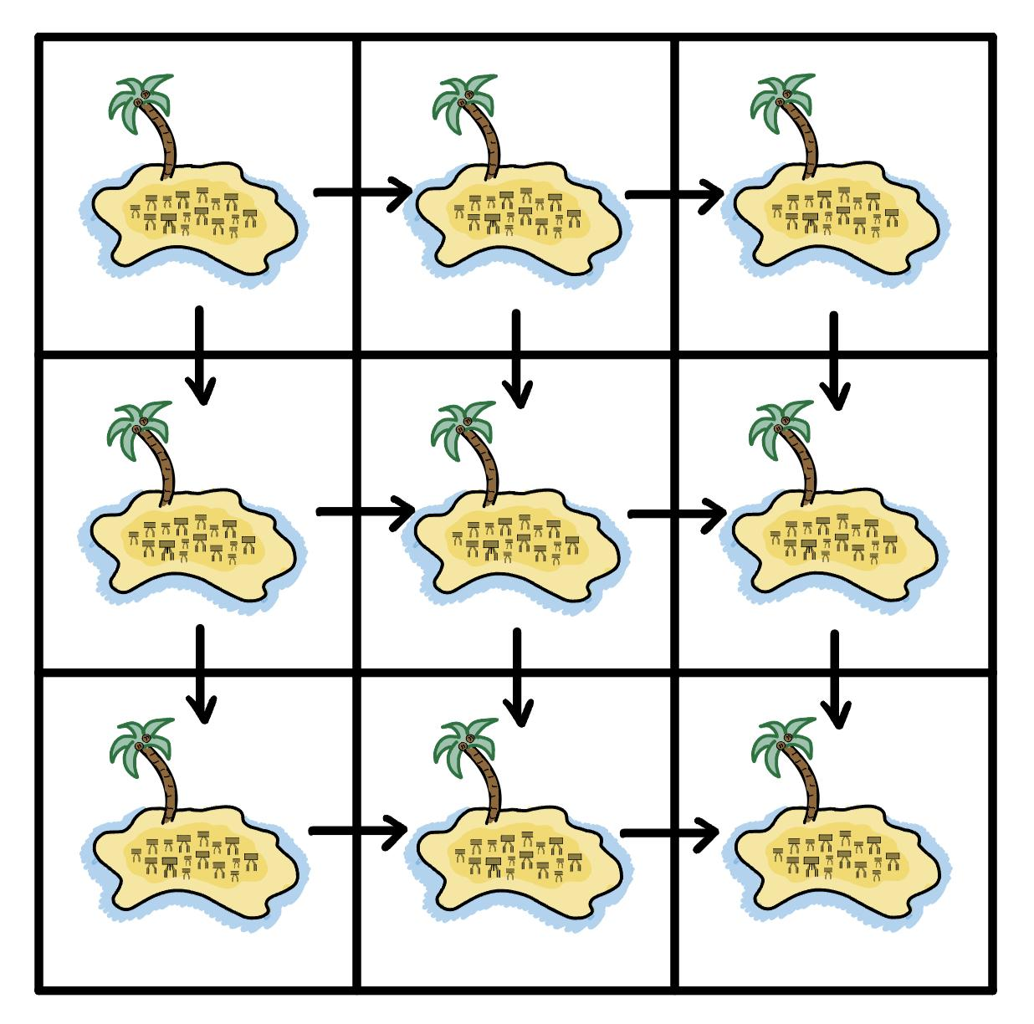
A Cartesian Topology

Slide 14
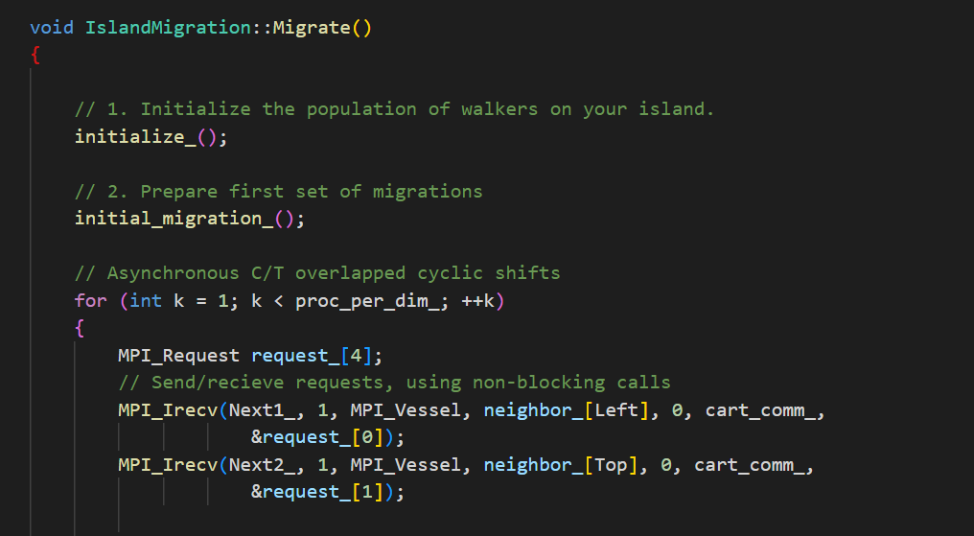
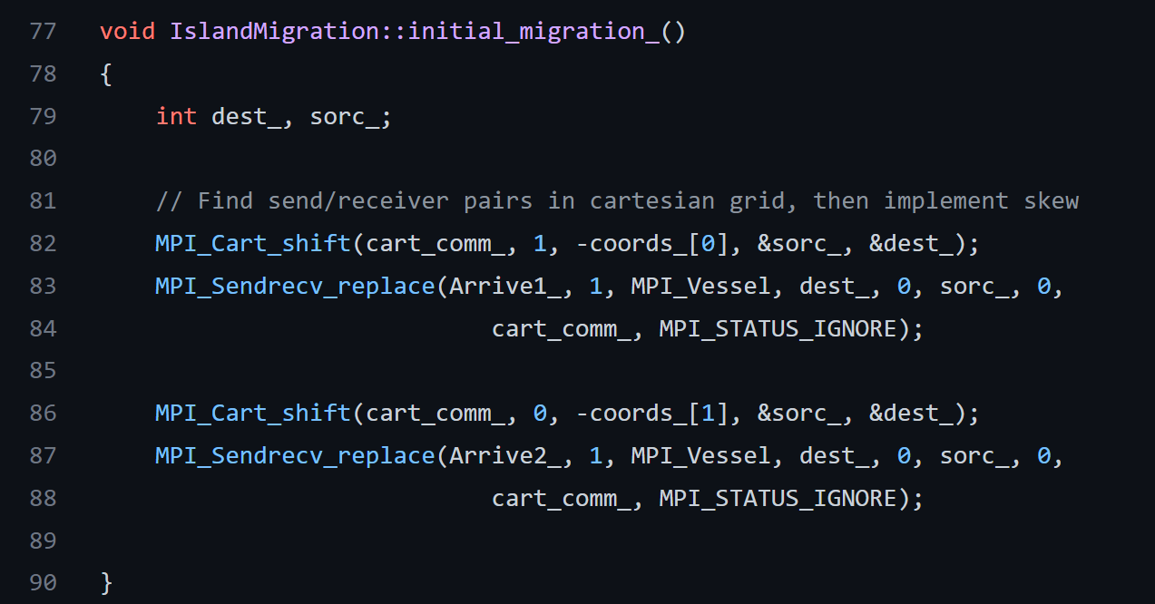
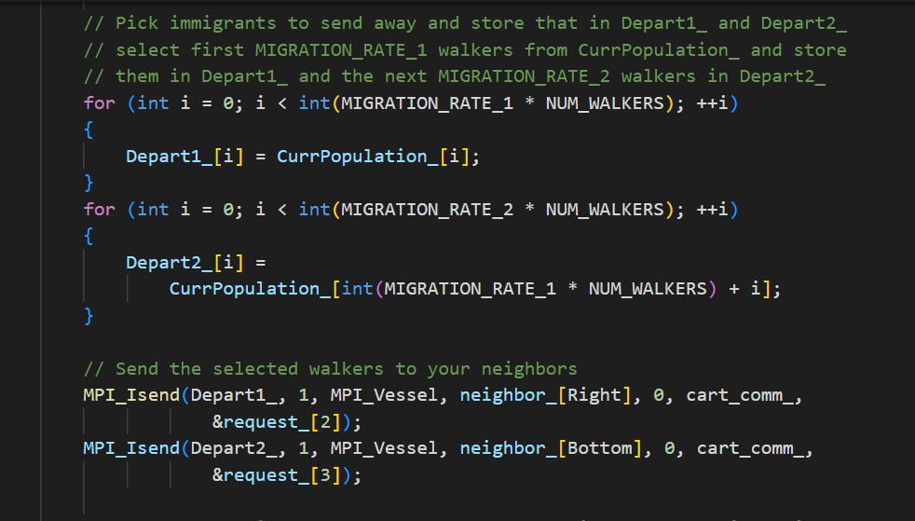

Slide 15
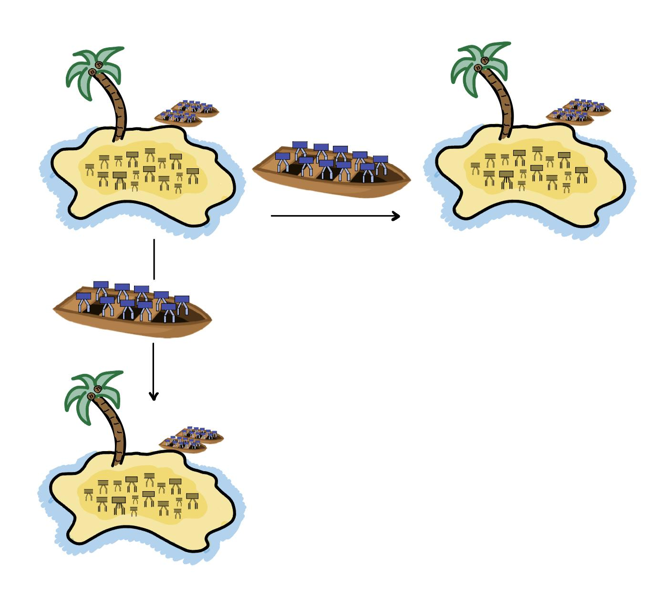
Non-Blocking Communication
We create two buffers Next1_ and Next2_ into which other islands send walkers. While we wait on the arrival of new walkers, we merge the old immigrants in Arrive1_ and Arrive2_ into our general population and go through a preselected number of generations. This is how we hide the communicated overhead.
Immigrant walkers from the previous communication iteration merge with their new island’s population!

Slide 16
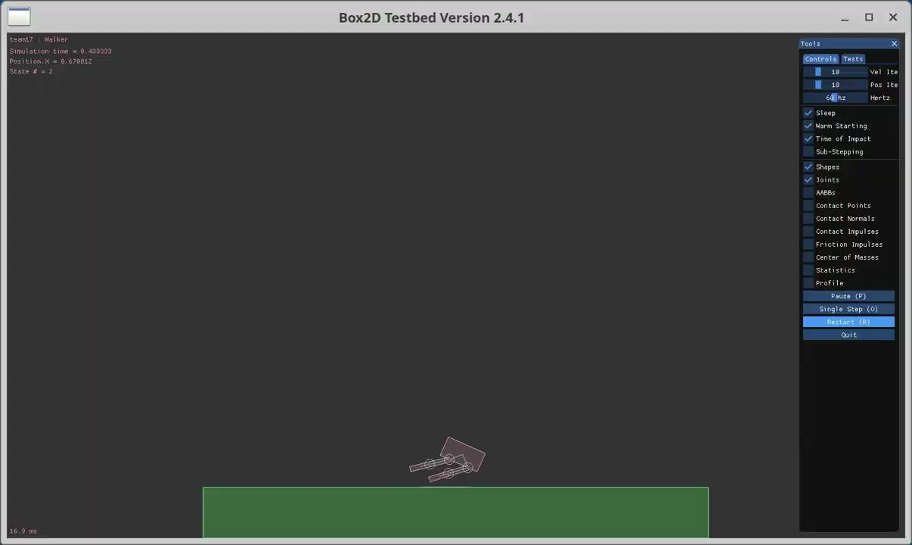

Visualizations
100 walkers; 150 gen. (75s); fittest 2 per gen.
4000 walkers; 150 gen. (75s); fittest 2 per gen.

